Slide 1
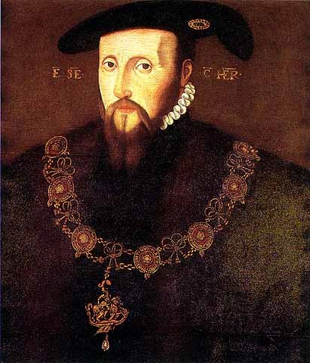
Lord Somerset
And his role within the government

Slide 2
William Paget: a trusted advisor to Somerset in a letter, May 1549
However it cometh to pass I cannot tell, but of late your Grace is grown in great angry fashions, whensoever you are contraried in that which you have conceived in your head. A king which shall give men occasion to discourage to say their opinions frankly receiveth thereby great hurt and peril to his realm. But a subject in great authority, as your Grace is, using such fashion, is like to fall into great danger and peril of his own person, beside that to the well-being of the nation.

Slide 3
William Paget: a trusted advisor to Somerset in a letter, July 1549
I told your Grace the truth and was not believed... The King’s subjects out of all discipline and all obedience, and care neither for you nor the King. What is the cause? Your softness, your wish to be good to the poor. It is a pity that your gentle approach should cause such evil as the rebels now threaten. A society is maintained by religion and law. Look carefully to see whether you have either law or religion, and I fear you shall find neither. I know that in the matter of your treatment of the common people every man in the Council dislikes your proceedings and wishes it were otherwise. Remember what you promised me.... Plotting with me to gain the place which you now occupy and that was to folly my advice in all proceedings more than any other man’s.”

Slide 4
So, what do we think of Somerset?
Use the sources, and the information on page 104-105 of your textbook to explain what kind of man you believe Somerset was.
(Booklet page 6)

Slide 5
To understand what happens to the succession...
...we need to understand what happens to Somerset.
We need to skip ahead to get a tiny summary of the rebellions.
We do not need huge detail- we may have questions, but it only needs to be brief.
For example...
Put your summary in the box on page 6 of your booklet, using pages 153-4 of your textbook.

Slide 6
Somerset: “who faced more determined and widespread opposition than any other Tudor government”
The Two Main Rebellions
The Western Rebellion: wanted religious change but did not aim to remove Edward. It also followed some increased taxes on sheep farming (big in the area) and seemed to be anti-gentry. They failed to take regional capital of Exeter and were also not supported by nobles or gentry.
The Kett’s Rebellion: also didn’t aim to remove the monarch but were angry at the gentry and their land enclosure. Again, no support from nobility or gentry.
Other disturbances- particularly around enclosure and long term economic developments and religious changes.

Slide 7
To understand what happens to the succession...
...we need to understand what happens to Somerset.
We need to skip ahead to get a tiny summary of the religious changes behind these religious changes.
We do not need huge detail- we may have questions, but it only needs to be brief.
For example...
Put your summary in the box on page 7 of your booklet, using pages 124-126 of your textbook.

Slide 8
Somerset’s religious changes
Somerset was a moderate Protestant.
His reforms were cautious and slow.
A royal visitation established the state of the clergy, the doctrine and church practices.
July 1547: model sermons provided, clergy ordered to preach in English. Chantries were dissolved. Treason act meant radicals could discuss reforms.
Act of Uniformity in 1549 enforced a number of Protestant reforms: e.g. clergy could marry, masses for the dead not approved, services in English etc. although there were still some Catholic practices.

Slide 9
The personal style of Somerset’s government
This was the main problem.
It led to an anti-Somerset faction- formed of people who had little in common but their dislike of Somerset’s method and policies.
This included Warwick (looking for advancement), Paget and Thomas Wriothesley (opposed to religious changes).
Following the rebellions, the opportunity to remove Somerset appeared.

Slide 10
Richard Grafton’s chronicle.
After these revolts were crushed, many of the Lords and councillors secretly plotted to overthrow the Lord Protector. Each lord and councillor went through London armed, and had servants likewise armed. They assembled at the house of the Earl of Warwick. They then published a proclamation against him containing the following charges.
First that through his malicious and evil government, the Lord Protector had caused all the recent unrest in the country. Second, he was ambitious and sought his own glory. Third, that he had ignored the advice of the councillors. Fourth that he told untruths about the council to the King.

Slide 11
The Removal of Somerset
Somerset fled to Hampton Court, taking the king with him and summoning loyal subjects to defend them.
He moved to Windsor Castle on 6th October, taking Edward with him.
However, Edward fell ill and complained of the cold surroundings, claiming he was held prisoner. Edward then abandoned Somerset and stated that his uncle had threatened riots in the streets if he was removed from power.
Somerset denied this, but could not contradict the king. His fate was sealed and his removal and arrest followed within the week.

Slide 12
So, was Warwick (the Duke of Northumberland) now in charge?
No.
The Council contained a majority of religious conservatives who did not trust Warwick.
Warwick brought in his own allies and removed opponents so that he had a Protestant majority on the Council.
Early December- rumours of a Catholic plot to remove Warwick, using the argument that he was a friend of Somerset.
Warwick used this, and claimed that “those who sought Somerset’s blood also sought mine”.
By January 1550, the leading Catholic members of the Council had been dismissed and Warwick was made Lord President of the Council.

Slide 13
So, was the Duke of Northumberland now in charge?
He placed his own supporters in important positions around Edward to further secure his own position.
This actually forced more radical religious developments.
Northumberland then attempted a reconciliation with Somerset who was released from jail.
Northumberland married his son to Somerset’s daughter.
Somerset continued to plot however, and this led to his execution in the end.

Slide 14
Storyboard time!
You have 8 boxes on page 8 of your booklet, and you can do with those 8 boxes what you will, as long as they summarise Somerset’s fall from power.
You have the textbook (pages 105-107) and an information page.
You need to highlight: why people were opposed to Somerset, how he was removed and what happened to him afterwards.
You then need to complete the questions on page 7.

Slide 15
The Source Activity on Page 106- do this one instead.
At some point, you will get a source booklet, which will have lots of the type of sources that you might get in your exam in it. It will include these sources. You have them on a piece of paper instead.
As you are all doing the A-Level, attempt this task instead:
What can we learn from the sources about the personality and actions of Somerset?
Use your knowledge of the events of 1550-1553 to assess how far they support that Somerset was guilty of involvement in a conspiracy against the Council.

